Slide 1
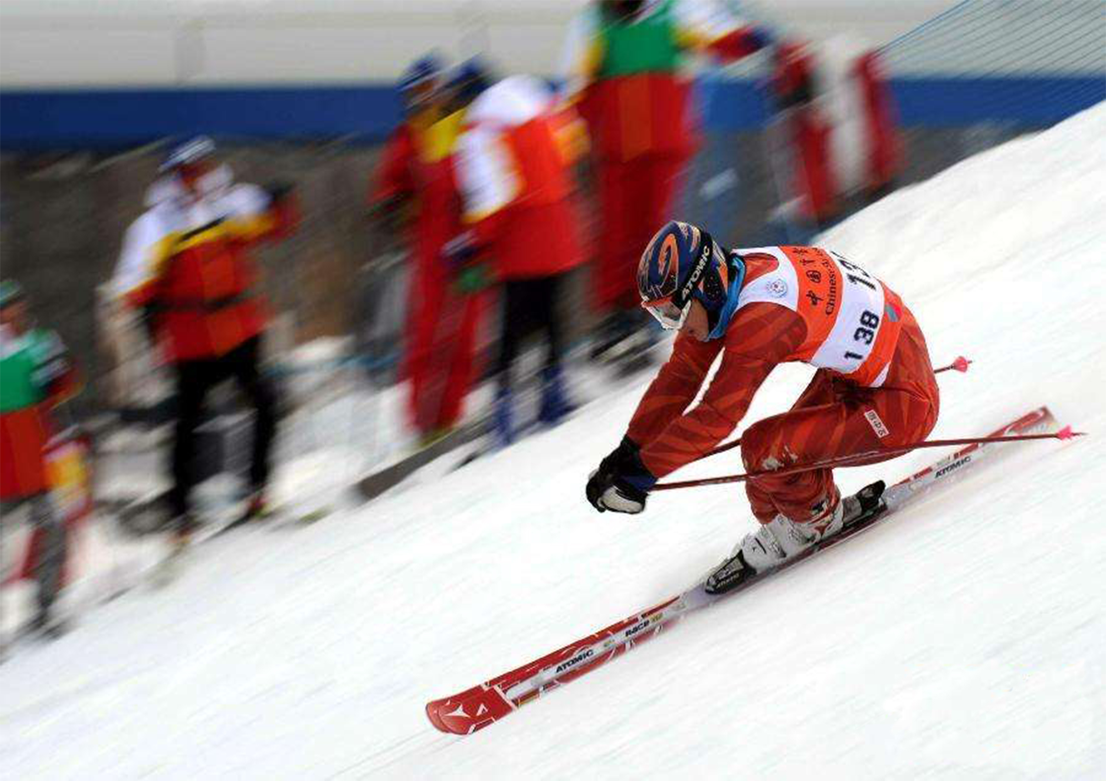
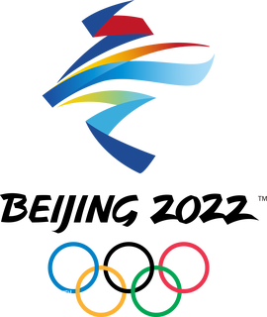
中华人民共和国科学技术部
Ministry of Science and Technology of the People＇s Republic of China
BEIJING 2022
The Path of Science, Technology and Innovation in China
—High-tech Winter Olympics
-- High-tech Winter Olympics
Notes:
Cover page and background image can be taken from China Science & Technology Network, Ministry of Science and Technology, Xinhua and other websites according to the content of the text, attached with a brief description of the photo and acknowledgement of its source.

Slide 2
中华人民共和国科学技术部
Ministry of Science and Technology of the People＇s Republic of China
Overview
To make the Beijing Olympic Winter Games a high-tech one, priority research tasks on zero-emission energy supply, green travel, 5G sharing, smart game-watching, sports technology, clean environment and safe games have been carried out. The aim is to provide critical technology support for running, participating and watching the Winter Games, and address the major needs of Winter Olympic projects and key application scenarios, thus helping present a streamlined, safe and splendid Games to the world.
In the organization of the Beijing Winter Olympic Winter Games, there is one area that is closely related to people’s lives, i.e. high-tech Winter Olympics. It is a concept that has been practiced in every aspect of the Beijing Olympic Winter Games, from infrastructure construction, event organization and venue operation to viewer experience and COVID containment. 5G, cloud computing, big data, satellite navigation, artificial intelligence...come and feel the power of technological innovation at the Winter Olympics.

Slide 3
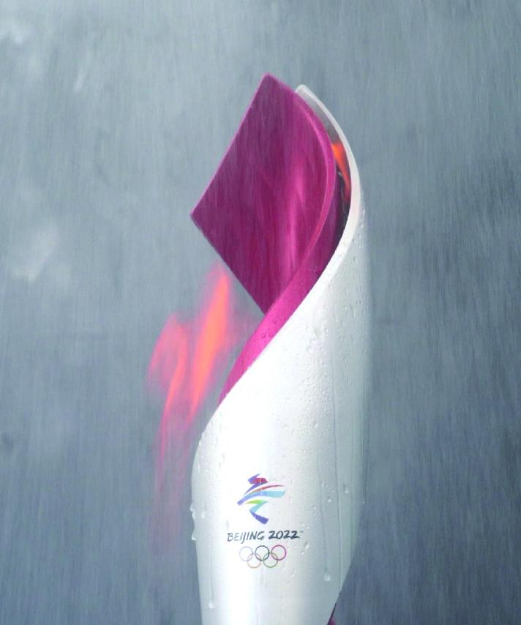
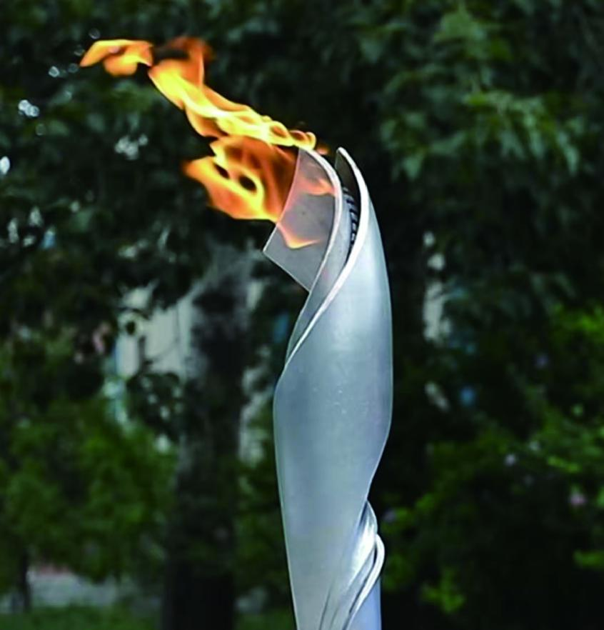
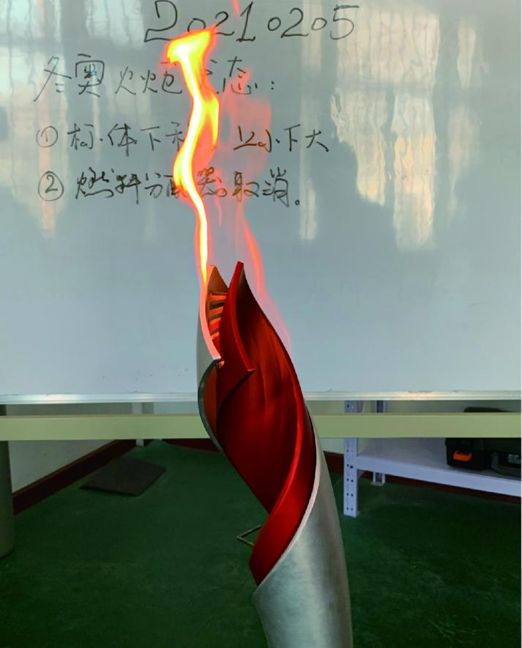
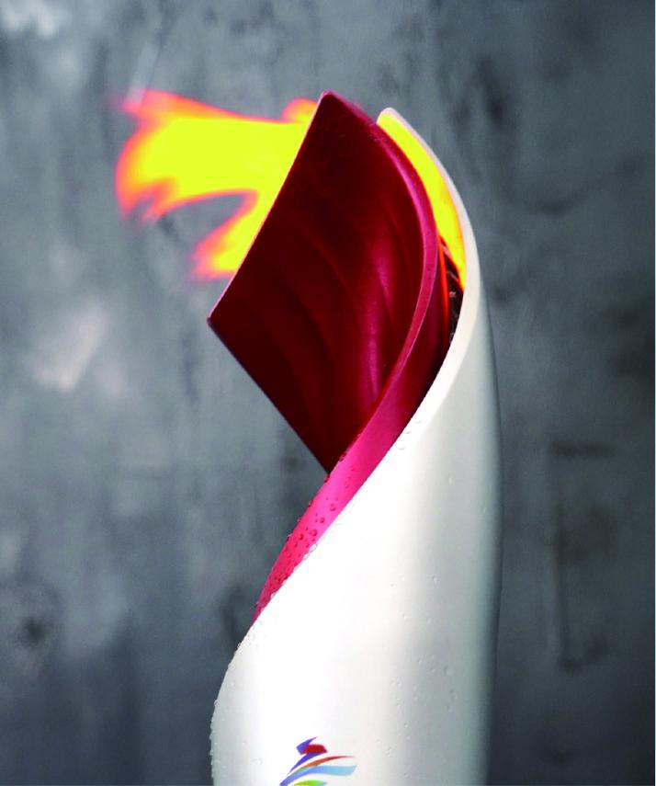
中华人民共和国科学技术部
Zero-emission energy supply
Ministry of Science and Technology of the People＇s Republic of China
Hydrogen-fueled handheld torch for the Winter Olympics - zero carbon emission & high stability
Using hydrogen as the fuel, the handheld torch produces zero carbon emission. This Olympic handheld torch has adopted the high-pressure hydrogen storage solution, and its combustion system has solved the problems of visibility of hydrogen flames, adaptability of complex curve surfaces, large scale decompression, and safe utilization of hydrogen, which makes it more adaptable to the environment. It has been tested and proven to be able to burn stably and reliably in harsh environments such as strong wind, heavy rain, low temperature, and high altitude. The Winter Olympic torch relay will help spread the concept of hydrogen utilization far and wide.

Slide 4
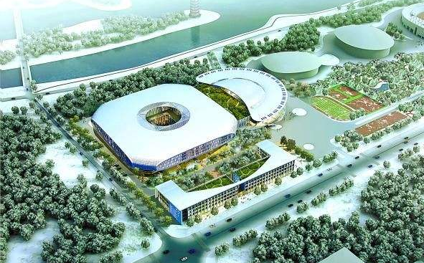
中华人民共和国科学技术部
Zero-emission energy supply
Ministry of Science and Technology of the People＇s Republic of China
100% green electricity supply
The preparations for the Beijing Winter Olympic Games, which are closely integrated with the development of the city and the region, have helped improve the region’s ecological environment, and boost socioeconomic development. During the Beijing Olympic Winter Games, all the 26 venues in the three major competition zones will be fully powered by “green electricity”, which means 100% green electricity for all competition venues for the first time in the Olympic history.
100% clean energy electricity supply for the first time
As a key supporting project for the Beijing Olympics Winter Games, the Renewable Energy Flexible DC Grid Demonstration Project in Zhangbei County is able to convert Zhangjiakou’s fluctuating wind power, photovoltaic and other clean energies into stable electricity and transmit it to Beijing, helping achieve 100% clean energy electricity supply of all competition venues in Beijing for the first time in the history of the Olympics.

Slide 5
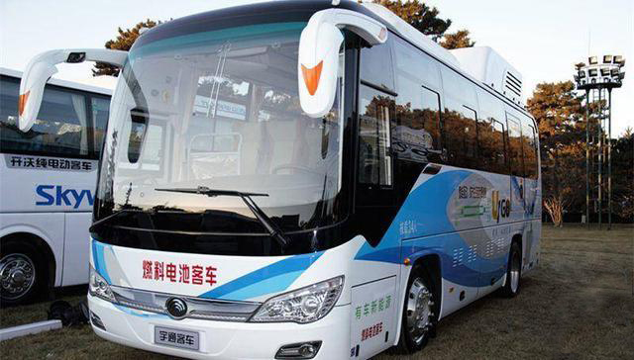
中华人民共和国科学技术部
Green Travel
Ministry of Science and Technology of the People＇s Republic of China
Low-carbon transportation system
During the Beijing Olympic Winter Games, 212 100% domestically-made hydrogen fuel cell buses will have access to hydrogen refueling services at the five “100% Green Hydrogen” hydrogen refueling stations, which is expected to save 0.28 liters of oil per kilometer for each vehicle, adding up to a total of about 9.6 tons. As a result, each vehicle emits 0.75 kilograms less carbon per kilometer, reducing carbon emission by a total of about 30 tons.
Energy-efficient and clean energy vehicles almost make up the entire minibus fleet and account for more than 80% of all vehicles, making a fully carbon neutral Beijing Olympic Winter Games.

Slide 6
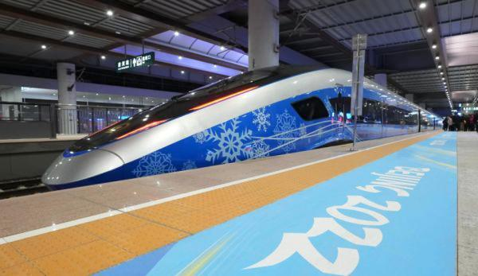
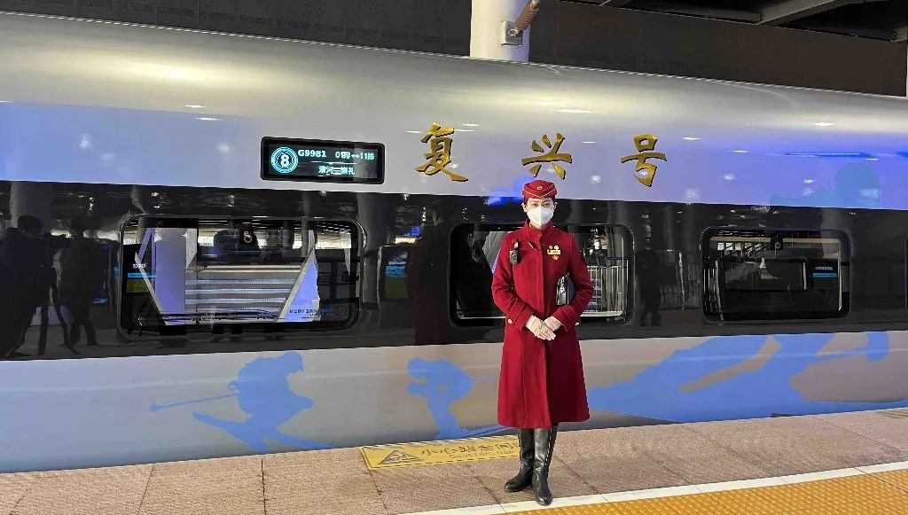
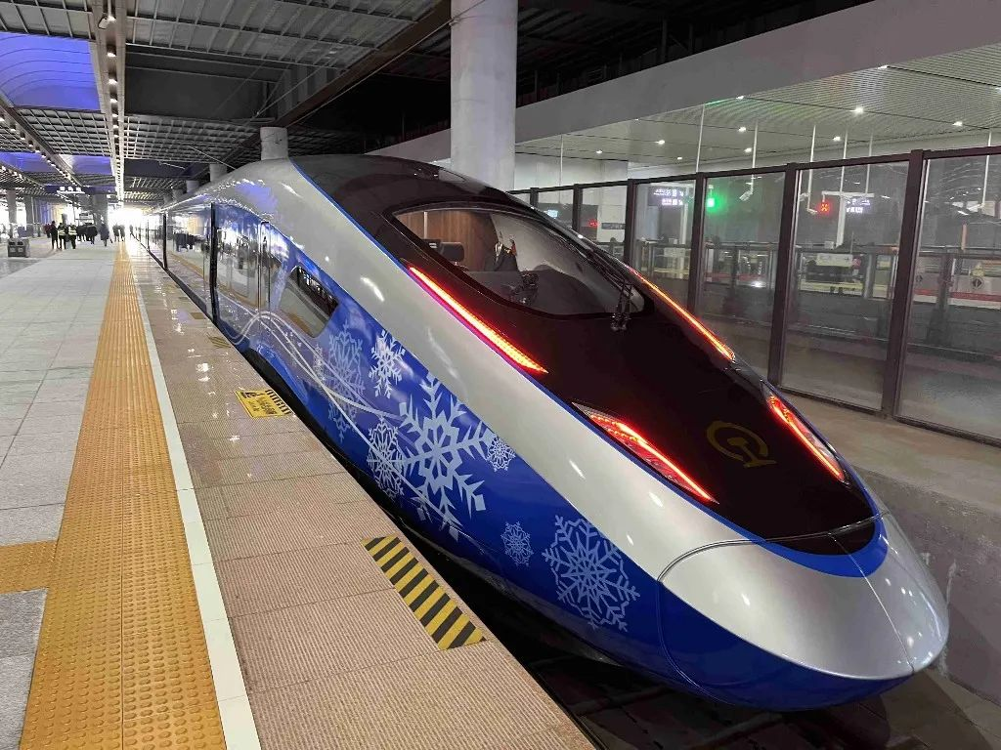
中华人民共和国科学技术部
Green Travel
Ministry of Science and Technology of the People＇s Republic of China
“Snow Dream” passenger service for the Winter Olympics on bullet trains along the high-speed railway linking Beijing and Zhangjiakou
“Snow Dream” passenger service on the Beijing-Zhangjiakou high-speed trains: English and Chinese interpretation service is provided in the cabin. Through the interpretation of the tour guide on the train, the passengers can better experience the Chinese technologies, Chinese speed and Chinese services. The trains on the Winter Olympic special line have specially prepared sleeping cushions and sleeping beds for children, so that infants and babies can enjoy a more comfortable and smooth ride. To help passengers find their luggage, the Beijing-Zhangjiakou high-speed trains are also equipped with an anti-loss device. Passengers can connect their mobile phones with the device via Bluetooth, and keep track of the location of their luggage, which makes them feel more reassured and helps avoid taking the wrong luggage.

Slide 7
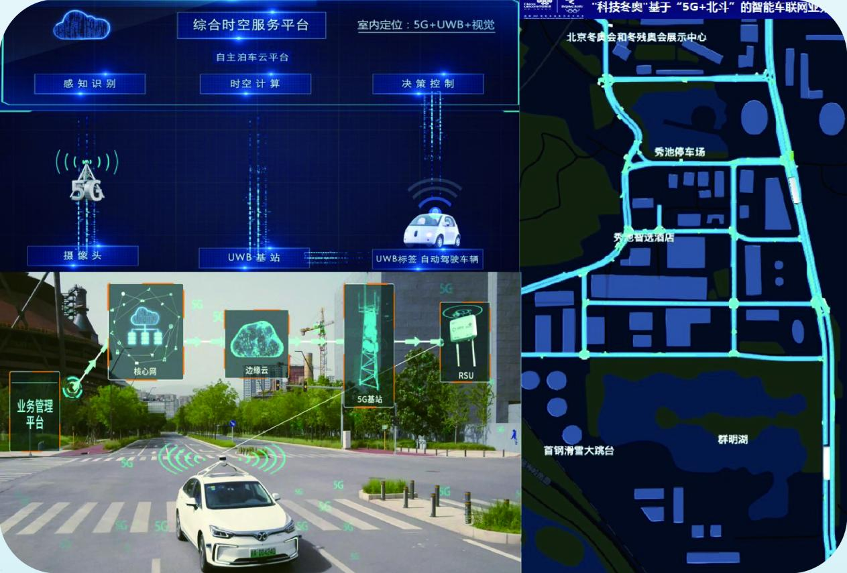
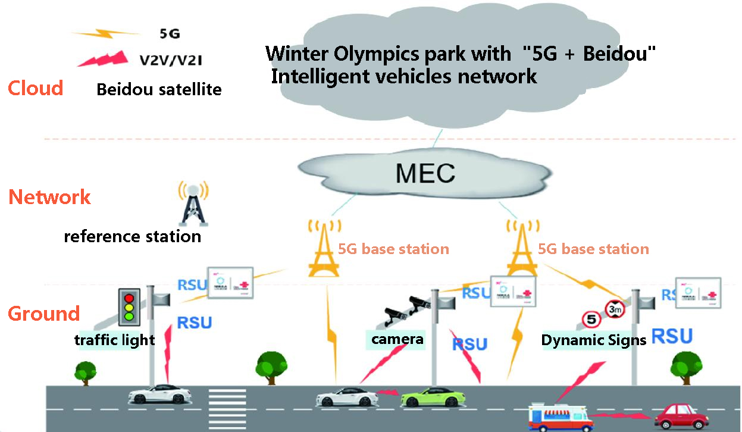
中华人民共和国科学技术部
5G Sharing
Ministry of Science and Technology of the People＇s Republic of China
Innovation of 5G-enabled, intelligent vehicle networking system
The 5G-enabled, intelligent vehicle networking system is in full application in Winter Olympic Parks. With the innovation of 5G + C-V2X fusion networking, network transmission delay is reduced to less than 10 milliseconds. Multi-source fusion and high-precision positioning based on 5G + BeiDou can satisfy the demand for continuous indoor and outdoor high-precision vehicle positioning at the 0.1 meter level. The L4 autonomous driving technology based on road-side all-area perception overcomes the limitations of narrow sight range and high cost caused by the dependence on vehicle body, which will accelerate the development of the automotive industry and give rise to new business models.

Slide 8
中华人民共和国科学技术部
5G Sharing
Ministry of Science and Technology of the People＇s Republic of China
Reliable 5G communication network in complex and extreme environments
The new 5G base station adapted to high altitude, high wind speed, high coldness and other harsh natural conditions has been providing stable live services for a year at an altitude of over 5,000 meters in the Mount Qomolangma (Mount Everest), achieving 5G communication under extreme natural conditions. The 200 megahertz large-bandwidth outdoor base station and the 300 megahertz ultra-large-bandwidth indoor base station equipment are able to meet the demands for large-bandwidth and high-capacity services during the Winter Olympics. They have been fully tested in the test tournament, and are able to provide safe, stable and reliable services for a long time, offering a potential solution for the construction of 5G networks in subsequent extreme scenarios.

Slide 9
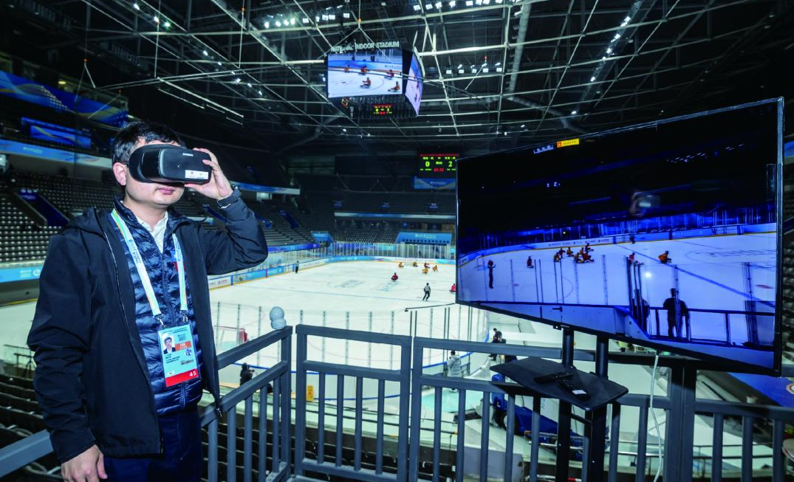
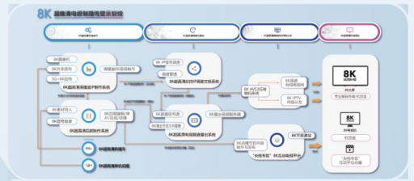
中华人民共和国科学技术部
Smart Game-watching
Interactive, multi-dimensional game-watching experience technologies and systems
Considering the special features of the ice and snow sports, homegrown 8K + VR live streaming system and 6DoF VR technology will be used in the demonstrative broadcasting of the Winter Olympics events. The viewers can watch VR live broadcasting through their cell phones, VR headsets and TV screens, overcoming the limitations of fixed perspective and passive viewing in traditional broadcasting and revolutionizing the user viewing experience. The project has given a boost to the development of ultra-high-definition VR content and the industry of VR display equipment and promoted the application of 5G technology. It will bring in more people to watch the games, add a new technological element to the Winter Olympics, and inject new impetus to the Winter Olympics economy.
Ministry of Science and Technology of the People＇s Republic of China
Ultra HD 8K digital broadcasting technology and system
The innovative 5G + 8K portable transmission system, which combines the 5G + 8K ultra HD transmission system with the ultra-high bandwidth of 5G network, provides 8K ultra HD video broadcast-quality coding transmission. Through the built-in 5G module multi-channel bandwidth intelligent data allocation, multi-channel data aggregation and other technologies, the system ensures 8K ultra HD video transmission in the 5G network with high stability, high reliability and high quality in a single-cameraman backpack scenario.

Slide 10
中华人民共和国科学技术部
Smart Game-watching
Ministry of Science and Technology of the People＇s Republic of China
Professional and accurate AI sign language interpretation
AI sign language anchor can not only report news, but also conduct live sign language broadcast of the events. This will be good news for hearing-impaired persons, as they can also enjoy the exciting events of the Winter Olympics. The AI anchor is a sign language translation engine and natural motion engine driven by voice recognition and natural speech comprehension technologies, with the ability to express in sign languages. With professional and accurate sign language commentary, “she” will present the “speed” and “passion” of the Winter Olympic to the audience.

Slide 11
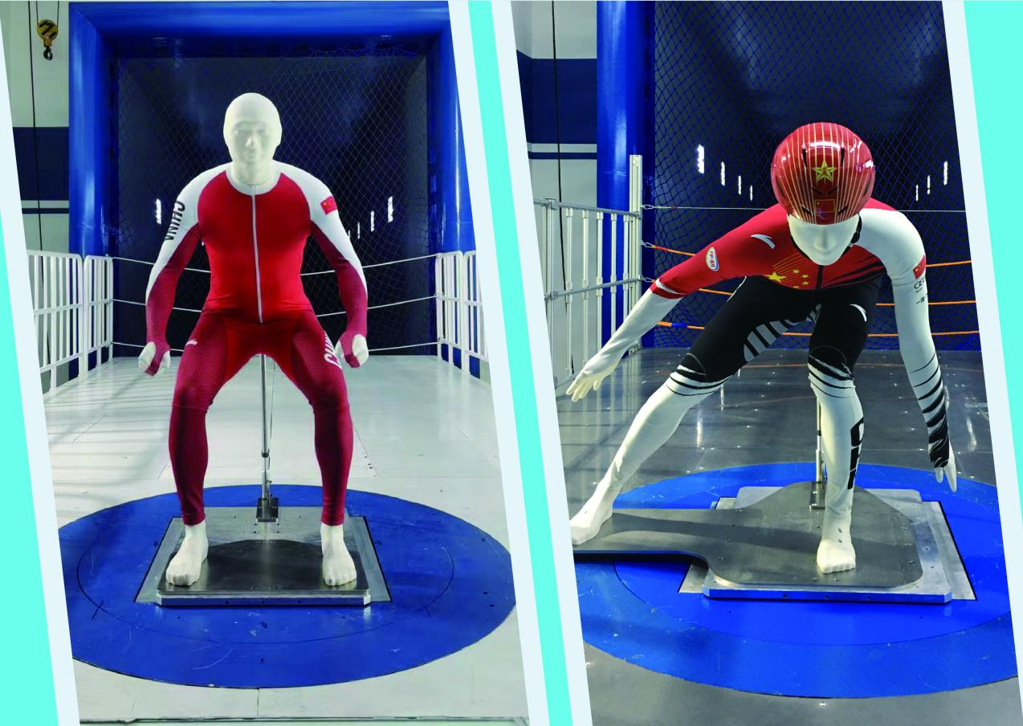
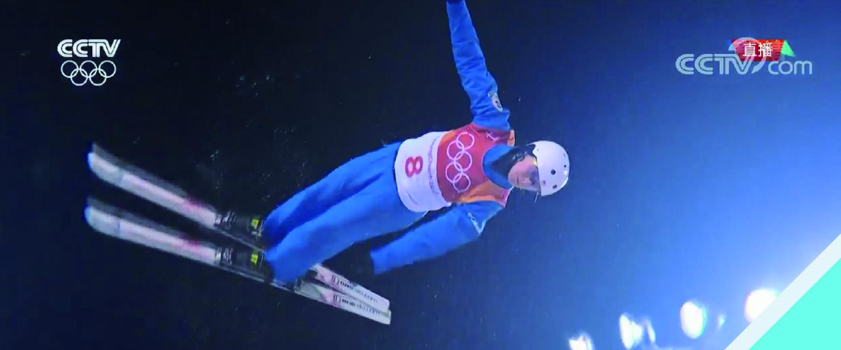
中华人民共和国科学技术部
Sports Technology
Ministry of Science and Technology of the People＇s Republic of China
Fast - tight-fitting suit for speed events
The race suits are specially designed for Chinese athletes based on their body features, with over 150 types of fabrics tested for basic performance. Most of them are for speed events such as short track speed skating, speed skating, and alpine skiing, and the drag reduction rate has exceeded 10% for several racing suits.
Beauty - enhanced athletic performance and visual impact
Exploring the impact of the visual elements of the clothes on athletic performance through the psychological evaluation of visual factors such as color science analysis and pattern, and the method of 3D simulation.

Slide 12
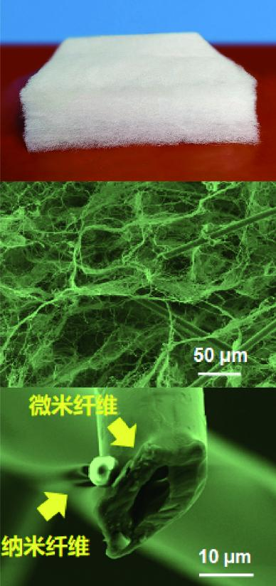
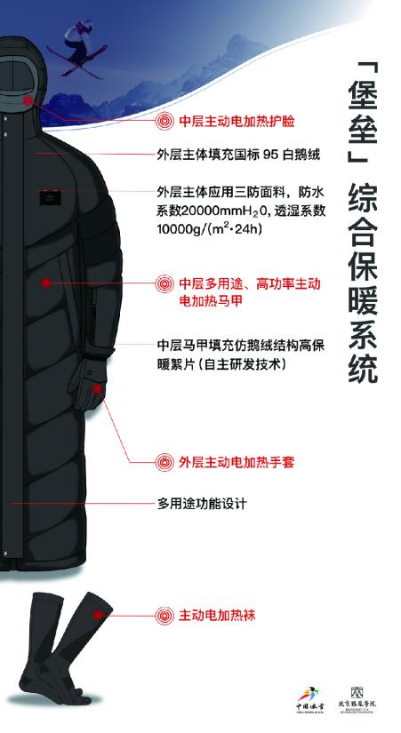
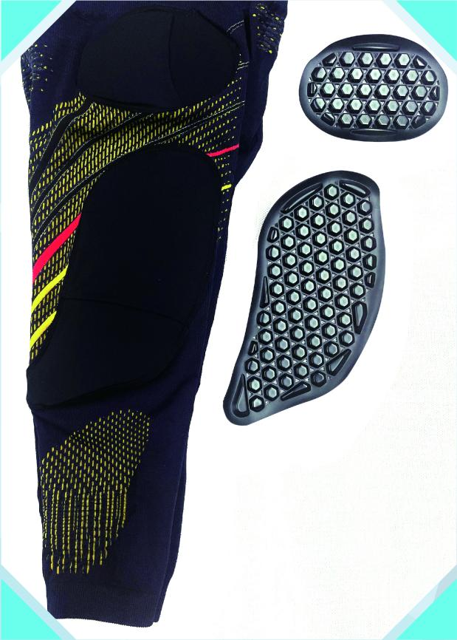
中华人民共和国科学技术部
Sports Technology
Ministry of Science and Technology of the People＇s Republic of China
Warm - protective clothes against low temperature
Warm wadding and flexible heating pad
Lightweight “faux goose down” structure warming wadding and high power density flexible heating pad.
Fortress Clothing
Advanced temperature self-adaptive clothing, with internal temperature monitoring, intelligent temperature regulation and other features.
Anti-stabbing and anti-cutting fabric for ice sports, super tough and cutting-resistant sports fabric tailor made for ice events, light weight and high elasticity, excellent performance of stabbing and cutting resistance.
Protection - protective gear and anti-stabbing and anti-cutting fabric in ice and snow events
Protective gear for snow sports, balancing protection with wearability and comfort.

Slide 13
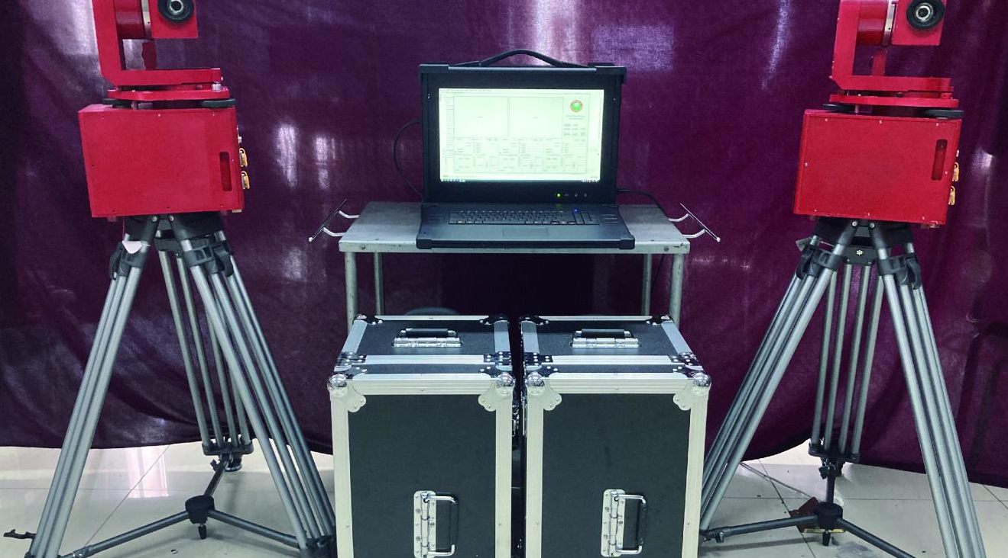
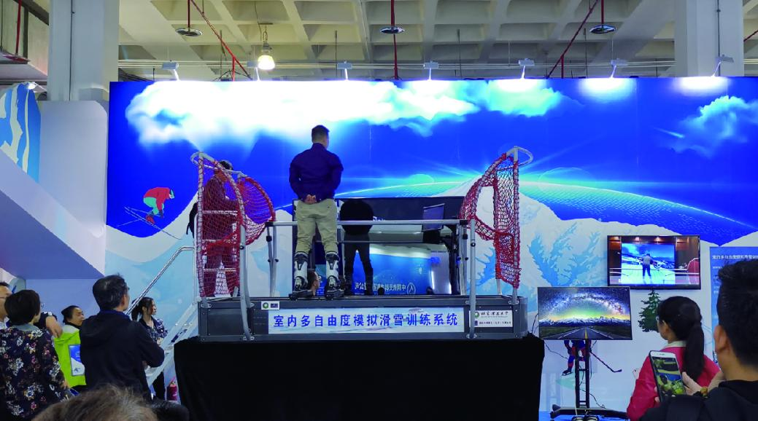
中华人民共和国科学技术部
Sports Technology
Ministry of Science and Technology of the People＇s Republic of China
Athlete technical movement acquisition - feedback - optimized application demonstration
Biomechanical fast feedback system for ski jumping. Setting up multiple high-speed, high-definition cameras to collect 3D motion data, and using artificial intelligence-based image recognition technology to automatically identify the location of each joint point of the athlete, and calculate the jumping stirrup distance, jumping joint angle, jumping vertical speed and other important indicators to realize 3D motion capture and analysis. BeiDou-enabled digital snow field feedback system. Using the BeiDou navigation system to digitize venue information and athletes’ skating trajectory, and get feedback on the height of jump, take-off speed, angle of jump, position movement, data comparison and other information.

Slide 14
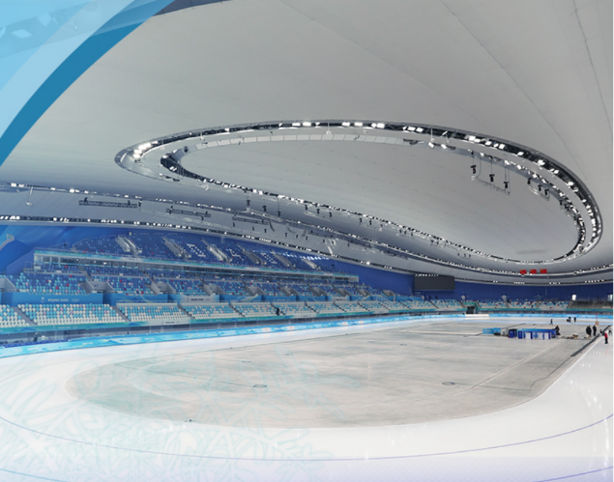
中华人民共和国科学技术部
Clean Environment
Ministry of Science and Technology of the People＇s Republic of China
Building low-carbon venues
Building low carbon venues. All venues have reached the green building standards; a new type of carbon dioxide refrigerant has been used in the four ice arenas, and more than 50,000 square meters of ultra-low energy demonstration projects have been completed.
Six venues of the 2008 Beijing Olympic Games have been used in the Beijing Winter Olympics. Inspired by the past experience of post-competition use, plans have been made for post-competition use for all new venues, and full consideration has been given to the venues' future use in the planning and design stage, which has proven effective in bringing down costs.

Slide 15
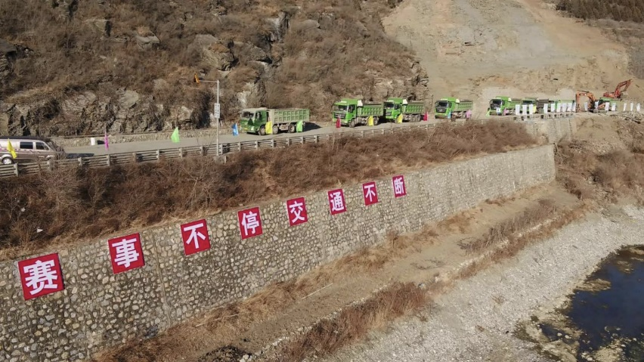
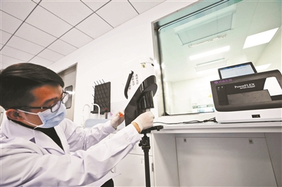
Advanced equipment ready for use in highway geological disasters
Portable high-throughput satellite stations, unmanned aerial vehicles, radar engineering reconnaissance vehicles, all-terrain vehicles, mechanized bridges, and other advanced communication security equipment and emergency rescue equipment, combined with digital and IT tools, provide the command site with all kinds of information on the disaster scene, so that the decision makers can quickly “remove the risks on the highway, coordinate the rescue efforts, clean up the debris from both directions, and prioritize traffic resumption”.
Safe Games
中华人民共和国科学技术部
Ministry of Science and Technology of the People＇s Republic of China
Collection of aerosol samples
During the Winter Olympics, aerosol samples will be collected at each competition venue, and then transferred to the testing station for testing. The results will be reported to the epidemic control departments within 4 hours to assist them in taking further measures based on the results.

Slide 16
中华人民共和国科学技术部
Ministry of Science and Technology of the People＇s Republic of China
Conclusion
High technologies have not only played a unique role in the preparations of the Beijing Winter Olympics, but will also serve people’s needs for a better life in the future. After the Beijing Winter Olympics, science and technology will continue to be an indispensable and important force in helping the general public have access to more diverse sports and enjoy the benefits of the Winter Olympics through the wider application of research outcomes.

